Slide 1
Introduction to
Express Js
{
<so lets the presentation begins >
}
...

Slide 2
What is Express.Js
Express is a Node.js Framework designed for building APIs , web applications and cross-platform mobile apps
Express is high performance , fast and light weight
It is used as a server-side scripting language
}
..

Slide 3
Features of Express.Js
Built for Node.js:
Express.js is specifically designed to work seamlessly with Node.js, taking advantage of its asynchronous, event-driven architecture.
Routing Simplified:
It simplifies the definition of routes, making it easy to handle different HTTP methods (GET, POST, etc.) and create modular and organized applications.
Middleware Functionality:
Express.js utilizes middleware functions, allowing developers to enhance the functionality of their applications by adding modular components that can handle specific tasks during the request-response cycle.
}
..

Slide 4
Features of Express.Js
Template Engine Integration:
It seamlessly integrates with template engines like EJS, Pug, or Handlebars, enabling dynamic content rendering on the server-side.
RESTful API Support:
It facilitates the creation of RESTful APIs, allowing developers to build scalable and maintainable backend services for their applications.
Error Handling:
Express.js offers mechanisms for handling errors in a straightforward manner, making it easier to identify and address issues during development.
}
..

Slide 5
Need of Express Js
01
02
03
Time Efficient
Fast
Easy to learn
04
Asynchronous
05
Easy to Debug

Slide 6
Routing in Express Js
{
<so lets the presentation begins >
}
...

Slide 7
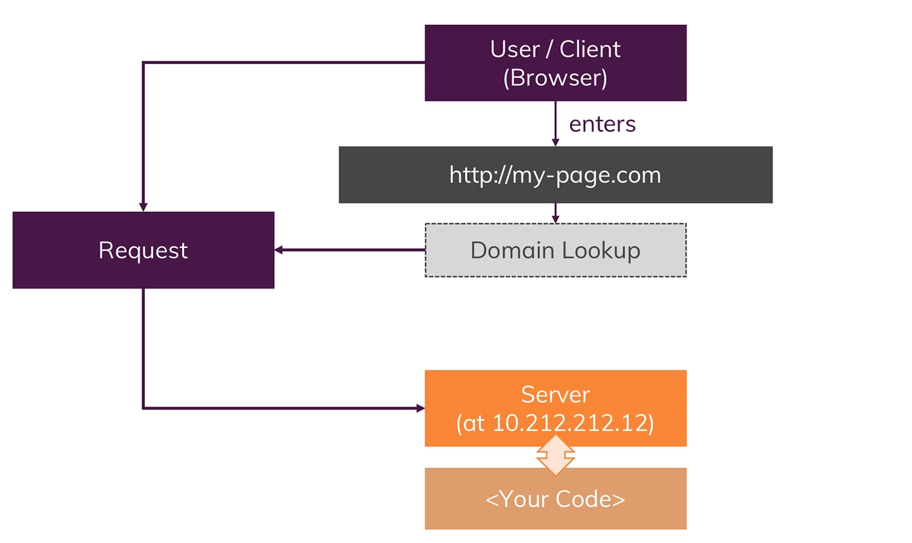
How web pages Works …?
Fast
Easy to learn
Asynchronous
Easy to Debug

Slide 8
Introduction to Routing
Definition:
Routing is like giving directions to different parts of your web application.
Imagine you're building a basic website with different pages:
When a user visits the homepage, they should see a welcome message.
If they go to '/about', they should see information about your website.
When they navigate to '/contact', they should find your contact details.

Slide 9
Example Of Routing
{
}
...

Slide 10
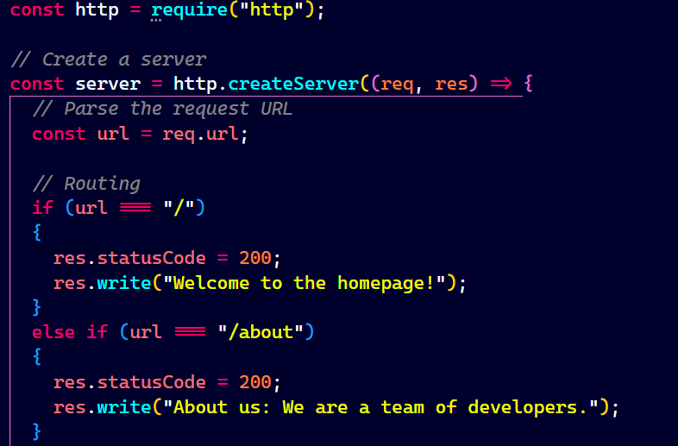
{
...

Slide 11
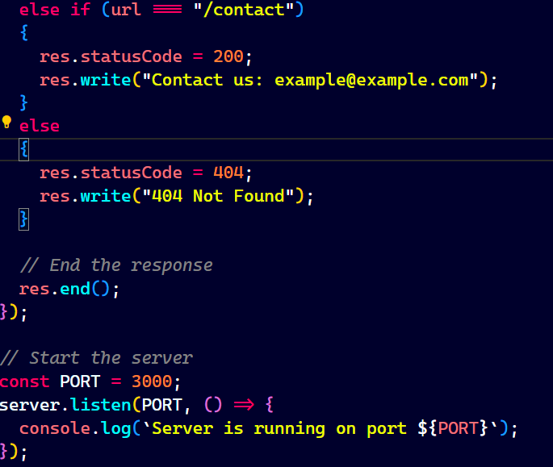
{
...

Slide 12
Routing in Node.js VS Express.js
Node.js : - Handling routing in Node.js requires manual configuration and can be complex.
Express.js :- Express simplifies routing with a straightforward and intuitive approach.

Slide 13
Routing In Express.js
{
}
...

Slide 14
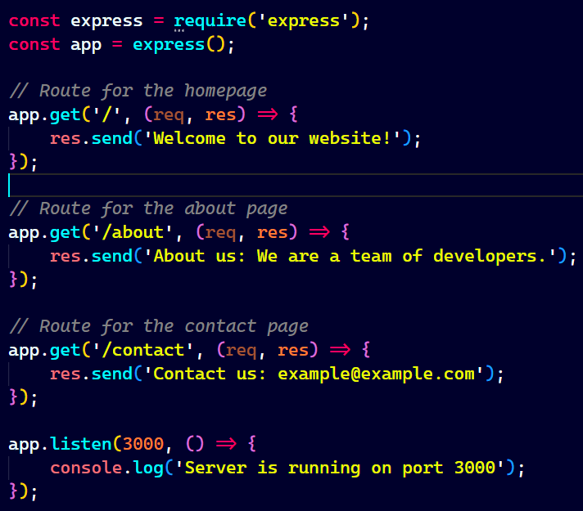
{
...

Slide 15
Benefits of Express.Js Routing
Easy Configuration: Define routes with simple syntax, reducing development time.
Modular Design: Routes can be organized into separate files for better code organization.
Middleware Integration: it will become very easy to use middleware functions to enhance routing functionality.

Slide 16
Middleware In Express.js
{
}
...

Slide 17
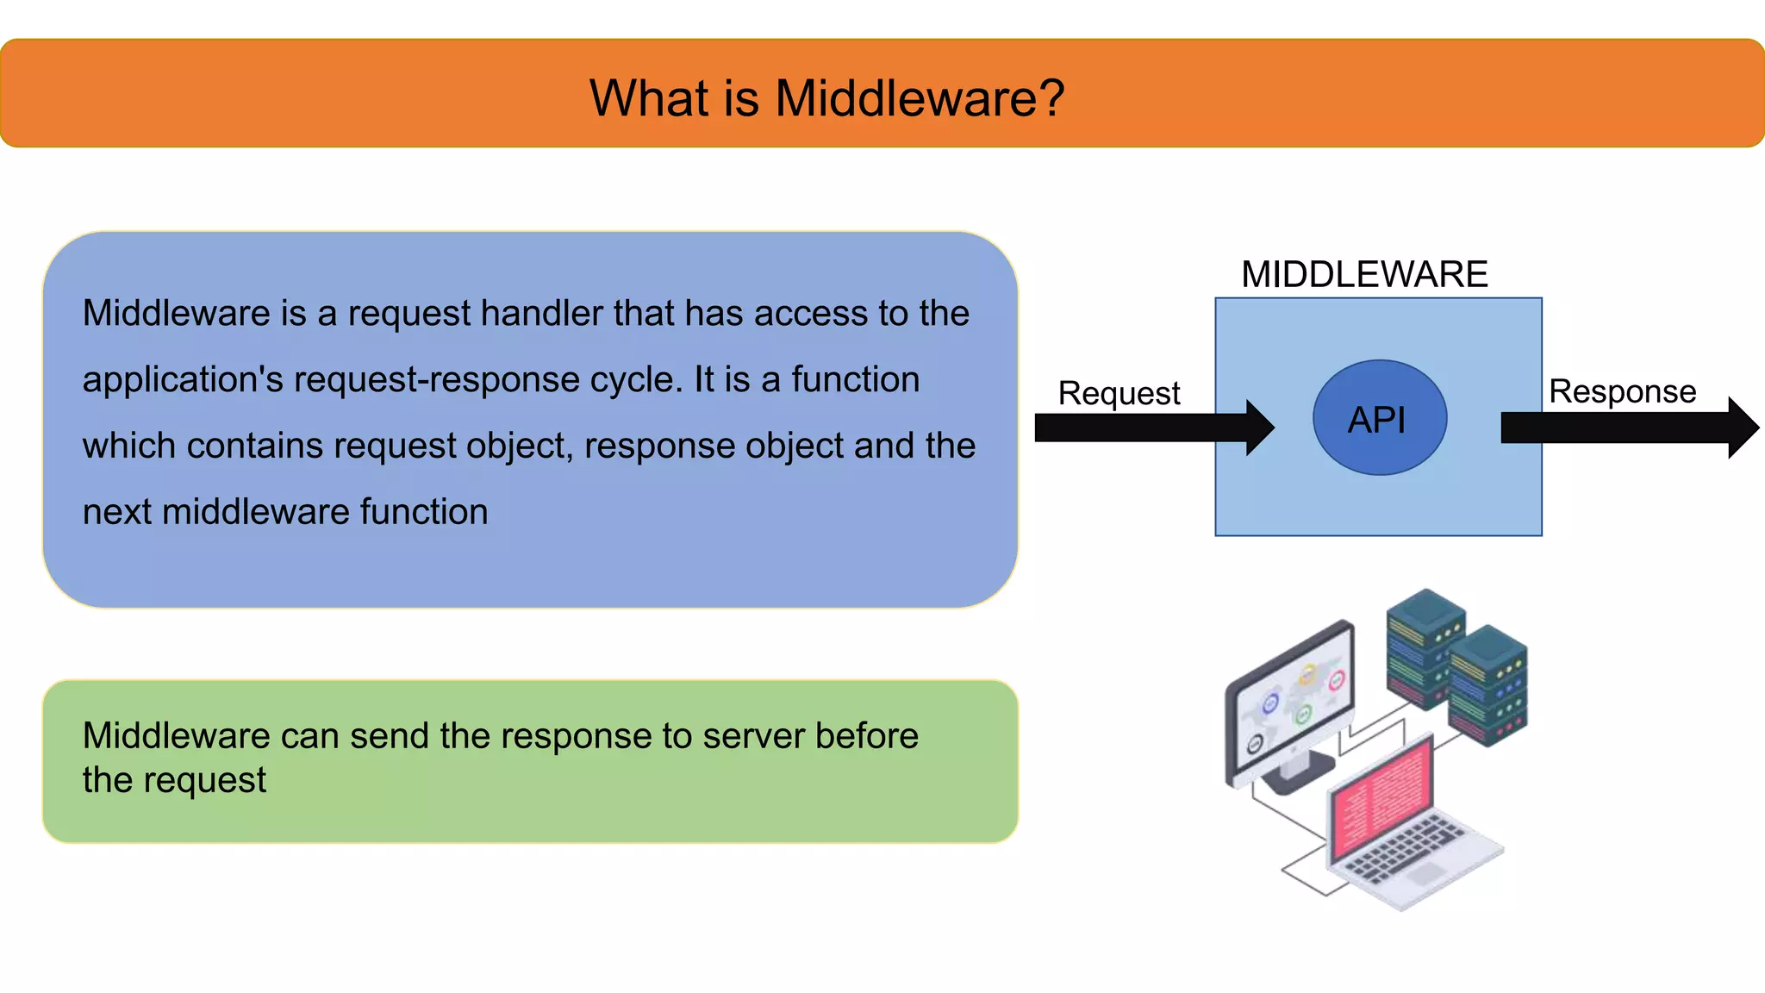
Benefits of Express.Js Routing
Easy Configuration: Define routes with simple syntax, reducing development time.
Modular Design: Routes can be organized into separate files for better code organization.
Middleware Integration: it will become very easy to use middleware functions to enhance routing functionality.

Slide 18
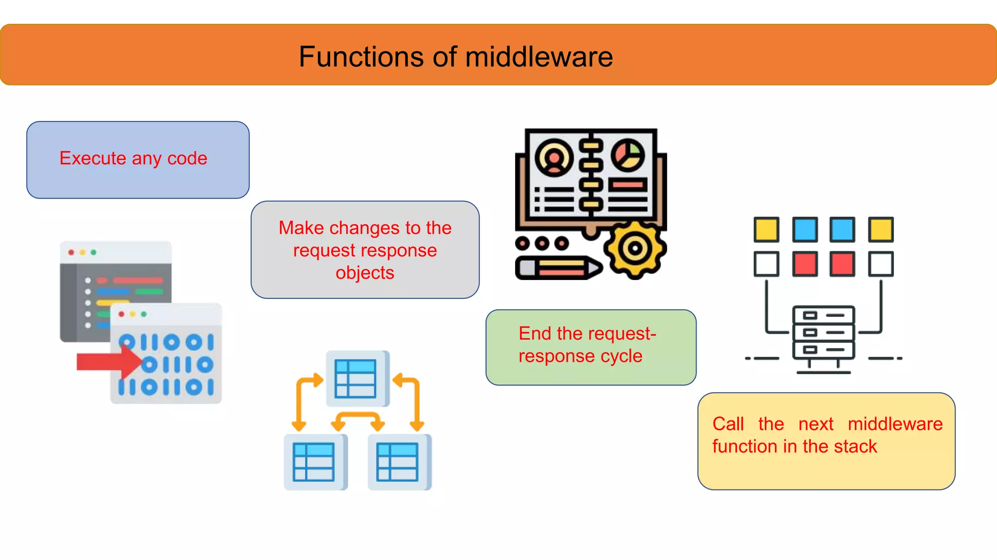
Benefits of Express.Js Routing
Easy Configuration: Define routes with simple syntax, reducing development time.
Modular Design: Routes can be organized into separate files for better code organization.
Middleware Integration: it will become very easy to use middleware functions to enhance routing functionality.

Slide 19
Example Of Middleware
{
}
...

Slide 20
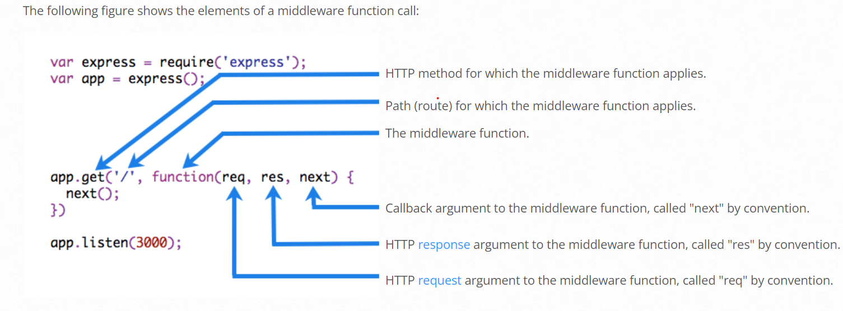
Elements of a Middleware

Slide 21
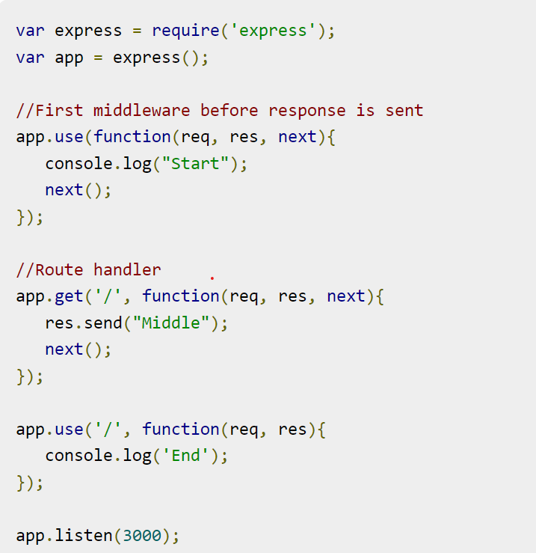
Example of Middleware
{
...

Slide 22
Error Handling
{
}
...

Slide 23
Error Handling
Error Handling refers to how Express catches and processes errors that occur both synchronously and asynchronously. Express comes with a default error handler so you don’t need to write your own to get started.
Catching Errors
It’s important to ensure that Express catches all errors that occur while running route handlers and middleware.
Errors that occur in synchronous code inside route handlers and middleware require no extra work. If synchronous code throws an error, then Express will catch and process it. For example:

Slide 24
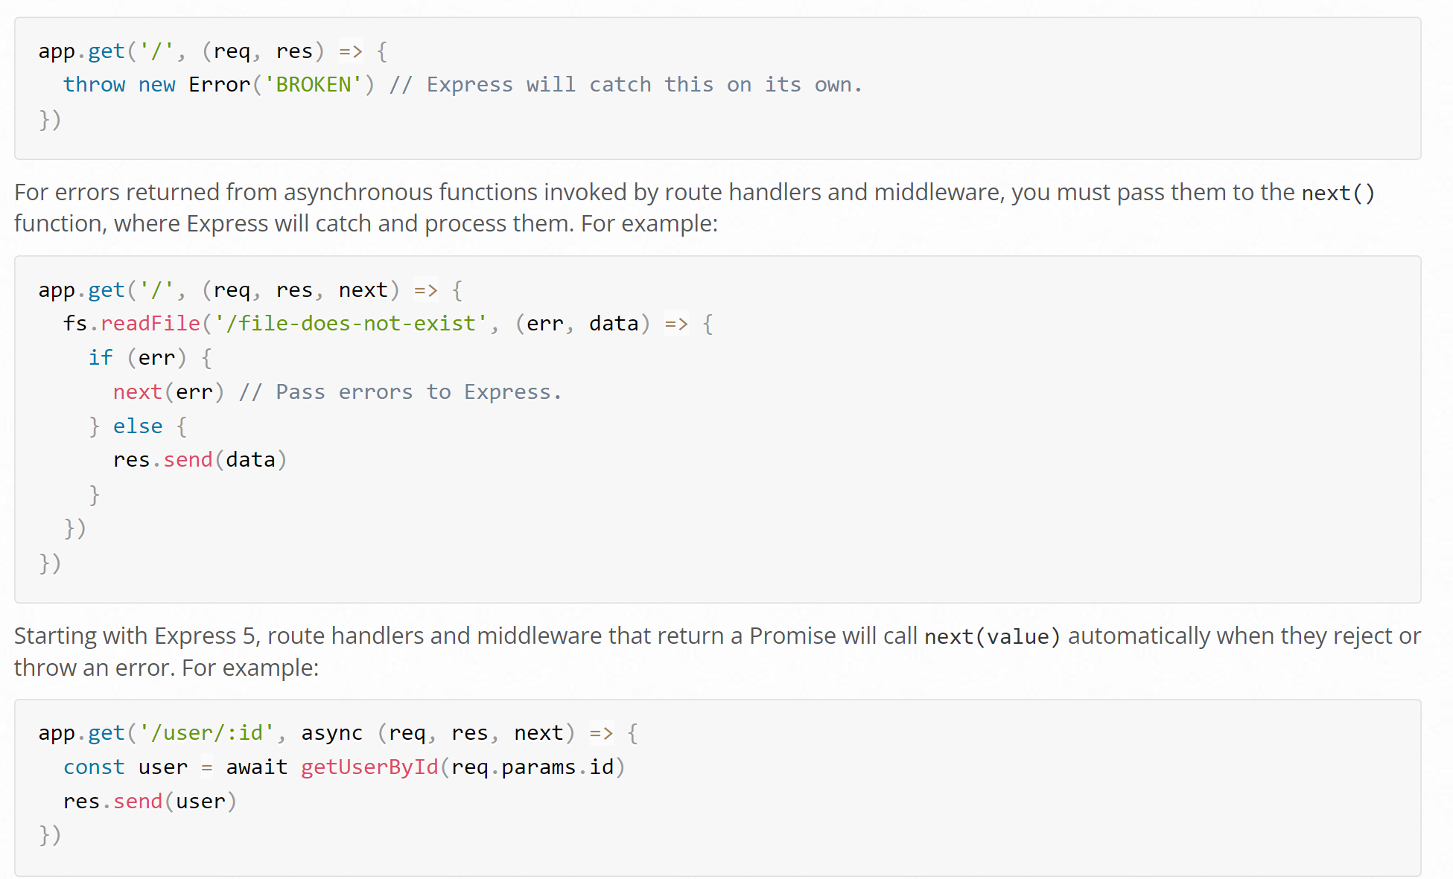
Example of
Error Handling
{
...

Slide 25
Error Handling
If getUserById throws an error or rejects, next will be called with either the thrown error or the rejected value. If no rejected value is provided, next will be called with a default Error object provided by the Express router.
If you pass anything to the next() function (except the string 'route'), Express regards the current request as being an error and will skip any remaining non-error handling routing and middleware functions.
If the callback in a sequence provides no data, only errors, you can simplify this code as follows
app.get('/', [ function (req, res, next) { fs.writeFile('/inaccessible-path', 'data', next) }, function (req, res) { res.send('OK') } ])

Slide 26
{
Writing error handlers
Define error-handling middleware functions in the same way as other middleware functions, except error-handling functions have four arguments instead of three: (err, req, res, next). For example:
app.use((err, req, res, next) => { console.error(err.stack) res.status(500).send('Something broke!') })
You define error-handling middleware last, after other app.use() and routes calls; for example:
const bodyParser = require('body-parser') const methodOverride = require('method-override') app.use(bodyParser.urlencoded({ extended: true })) app.use(bodyParser.json()) app.use(methodOverride()) app.use((err, req, res, next) => { // logic })
...

Slide 27
Introduction to MVC
{
}
...

Slide 28
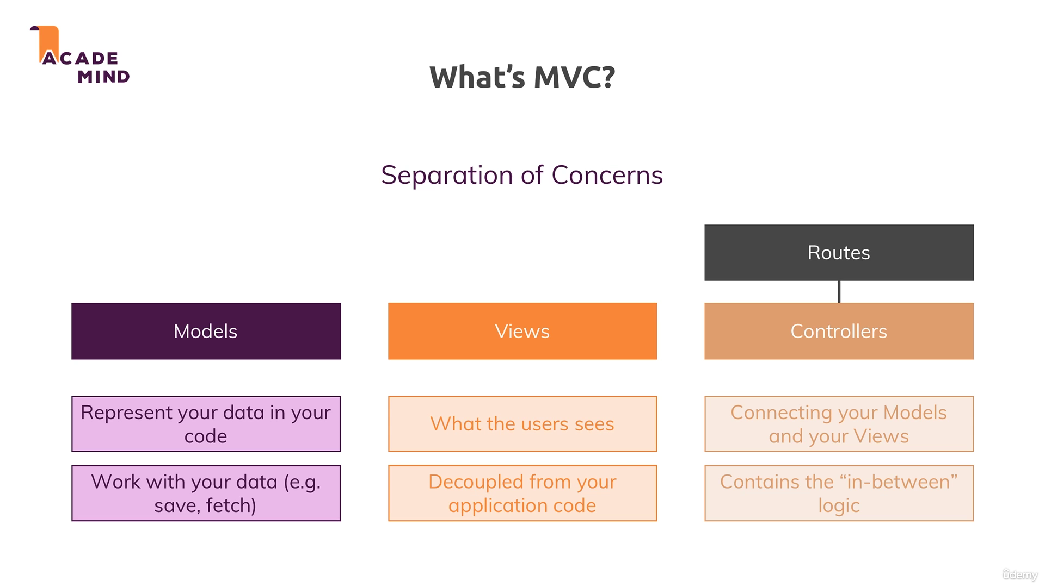
How web pages Works …?
Fast
Easy to learn
Asynchronous
Easy to Debug

Slide 29
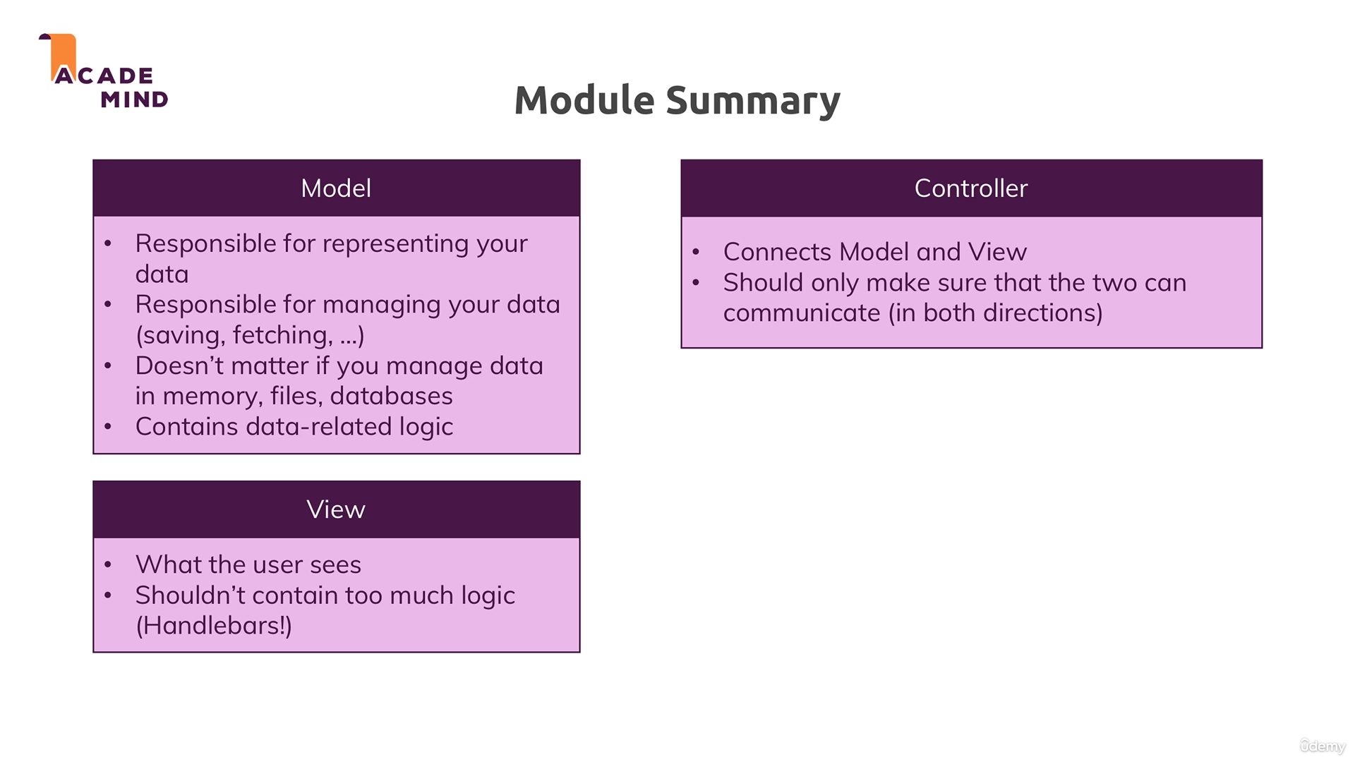
How web pages Works …?
Fast
Easy to learn
Asynchronous
Easy to Debug

Slide 30
Templating Engines
{
<so lets the presentation begins >
}
...

Slide 31
Introduction to Templating Engines
Definition:
For putting dynamic content into the html pages we would something called Templating Engines

Slide 32
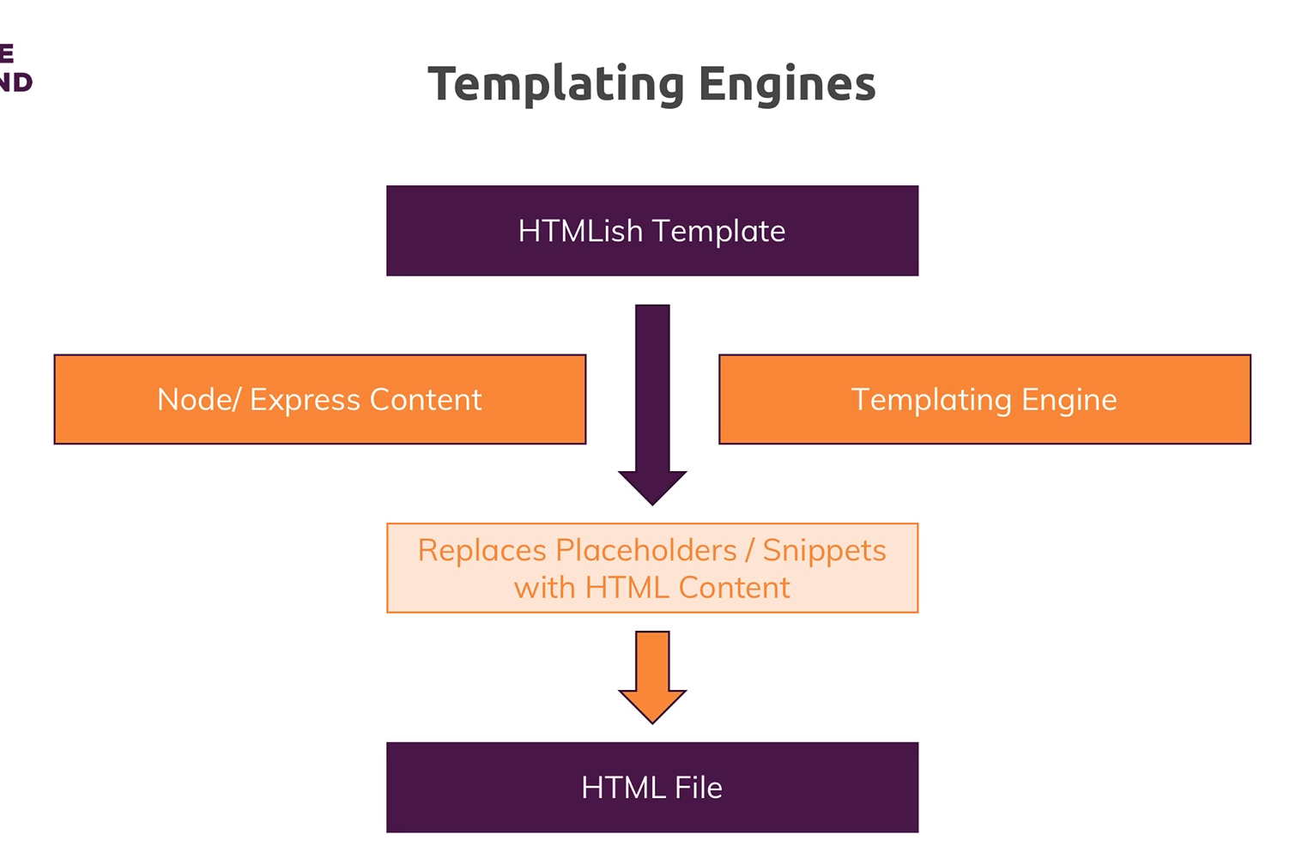
How Templating Engines Works …?
Fast
Easy to learn
Asynchronous
Easy to Debug

Slide 33
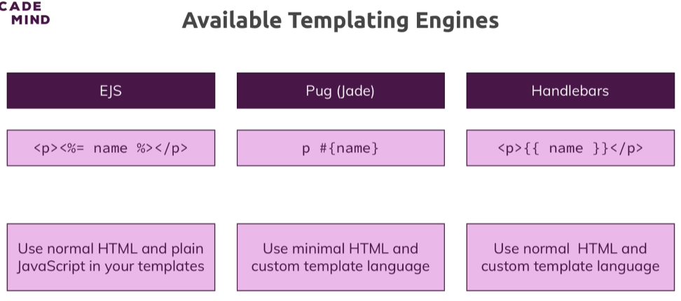
Types of Templating Engines

Slide 34
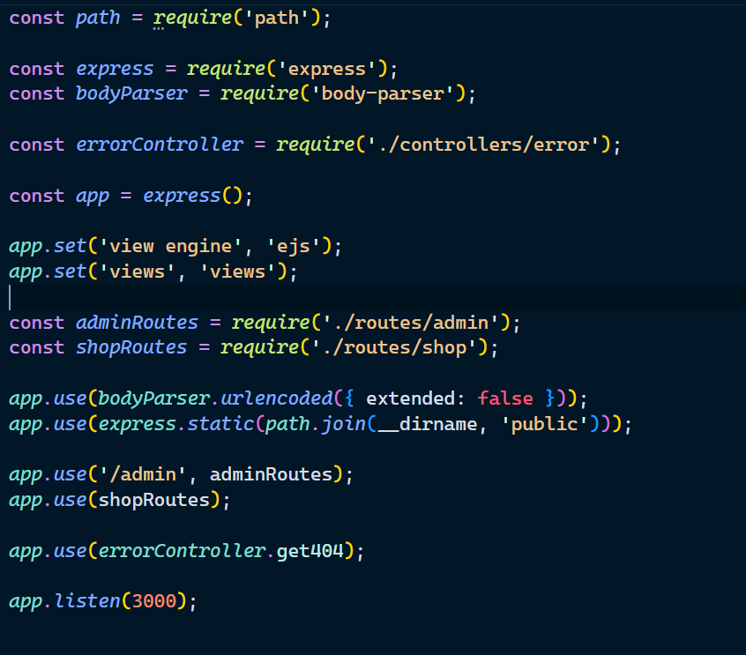
{
...

Slide 35
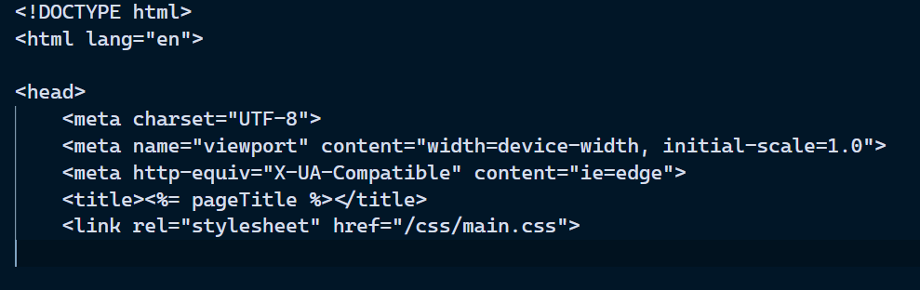
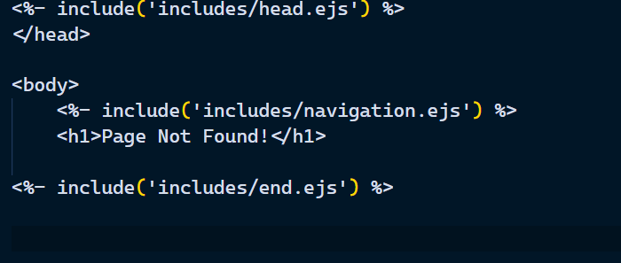
{
...

Slide 36
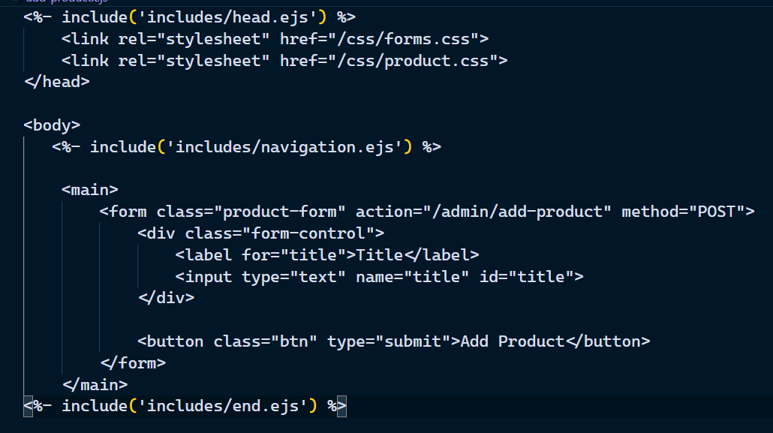
{
...

Slide 37
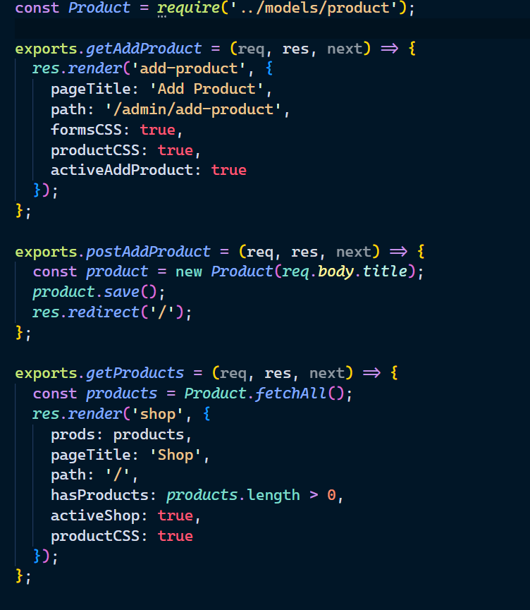
{
...

Slide 38
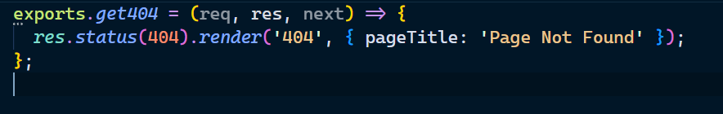
{
...

Slide 39
Thank You
{
}
...

